Slide 1
Time in Distributed Systems
V1-4
Time in Distributed Sytems

Slide 2
Types of Time
Sundial time
Zone time
Mean time
Political time
Universal time (UTC, Uniform, Zulu)
Local (e.g. ships) time
Atomic time
V1-4
Time in Distributed Sytems

Slide 3
Why have time services?
Synchronize clocks in different computers
Determine the order in which events occur
To support many distributed algorithms
V1-4
Time in Distributed Sytems

Slide 4
Time Service Issues
Clock drift
Synchronization
V1-4
Time in Distributed Sytems

Slide 5
Clock Drift
Identical clocks vary
  minor component differences
  minor manufacturing differences
  environmental differences e.g. temperature
Error about 10⁻⁶ or 1 second in 11.6 days
V1-4
Time in Distributed Sytems

Slide 6
Synchronization
Accurate clocks exist
Communicating the time is subject to:
  transmission delays (jitter)
  Operating system induced delays
V1-4
Time in Distributed Sytems

Slide 7
Types of Time
Atomic time
Astronomical time
Co-ordinated Universal Time (UTC) aka Universal Time (UT)
V1-4
Time in Distributed Sytems

Slide 8
International Atomic Time (TAI)
Based on the vibration of sub atomic particles in cesium 133 clock.
9,192,631,770 transitions per second
Measures intervals from 1/1/58
The average of several atomic clocks are used to set a world time standard (Bureau International del’Heure (BIH))
V1-4
Time in Distributed Sytems

Slide 9
Astronomical Time
Based on the rotation of the Earth about its own axis and around the sun.
Does not map precisely on to the calendar
Different calendar in different parts of the world – china, star-trek
V1-4
Time in Distributed Sytems

Slide 10
Universal Time
Man-made time system in everyday use.
Global standard.
Based on atomic time with appropriate leap seconds and days added to keep it in sync with universal time.
86,400 TAI seconds in ~ 3mS less than a mean solar day
When difference is 800ms leap second introduced
V1-4
Time in Distributed Sytems

Slide 11
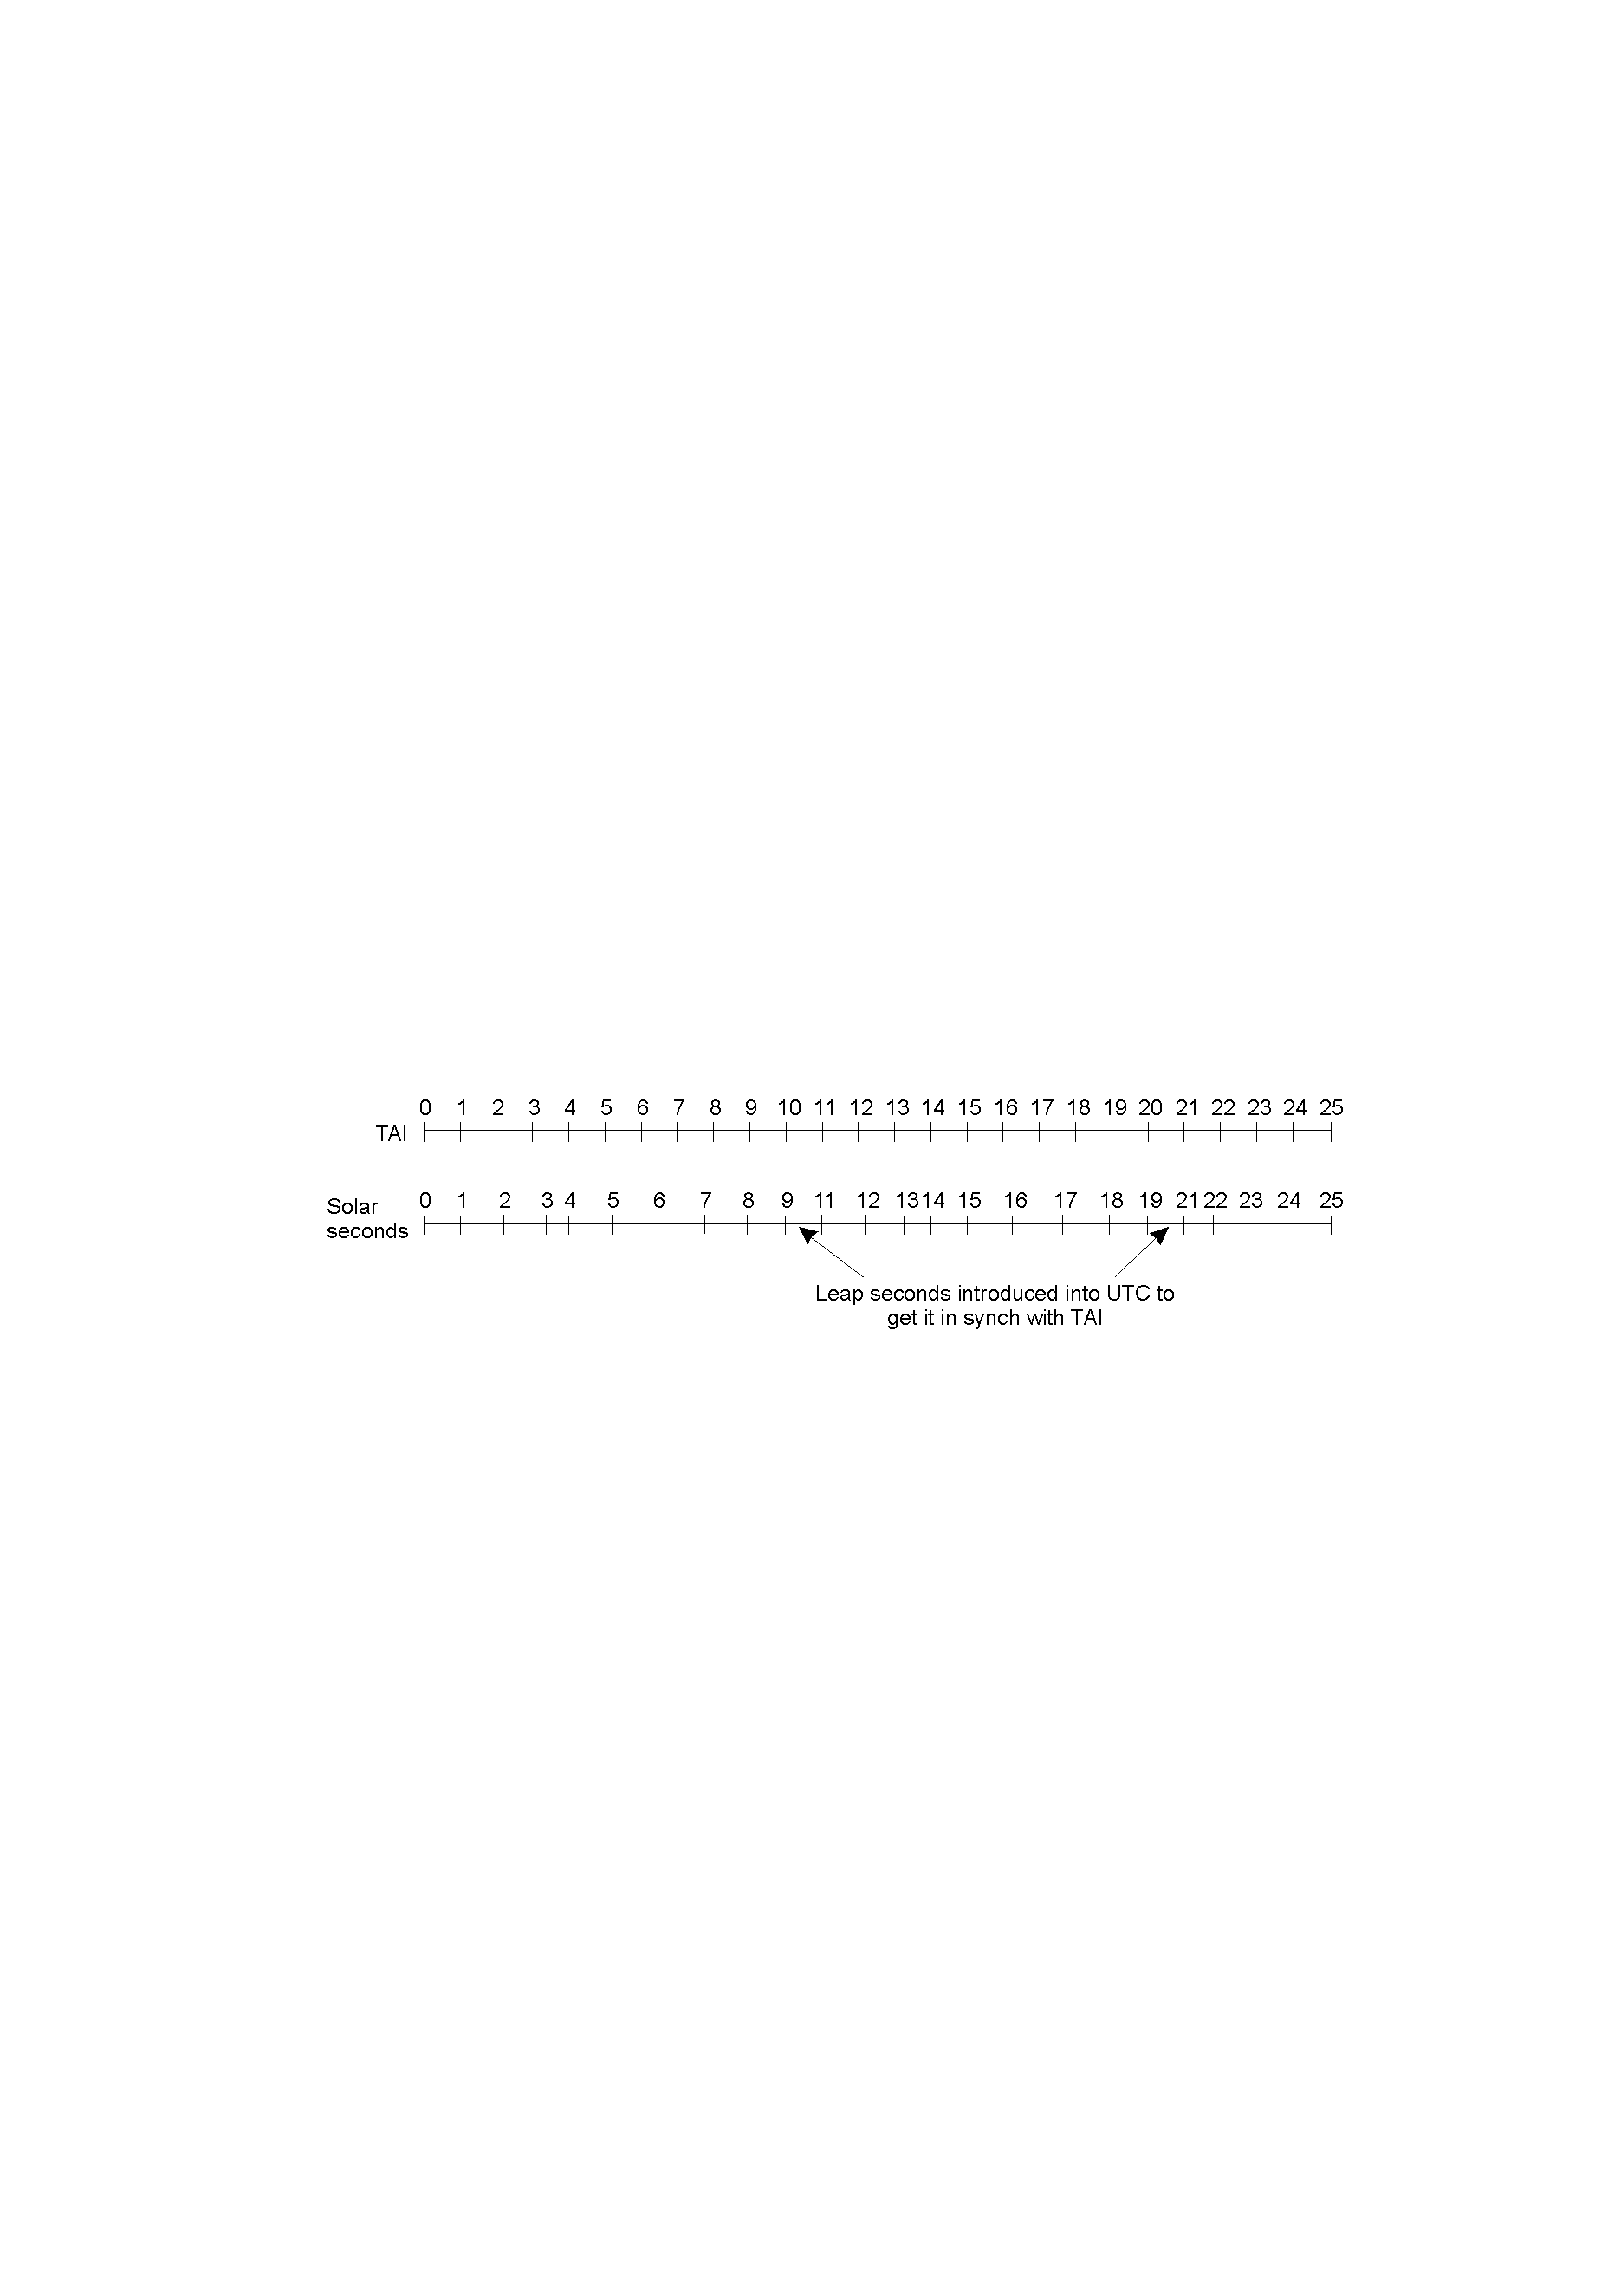
Universal Time
V1-4
Time in Distributed Sytems

Slide 12
Universal Time
Broadcast by radio stations and satellites (e.g. gps)
Receivers exist that connect to computers enabling them to synchronise with UT.
Synchronised with frequency of mains power
Pope Gregory knew all about universal time!
V1-4
Time in Distributed Sytems

Slide 13
Universal Time
In 1582 Pope Gregory XIII declared 10 days be omitted from the calendar
Riots ensued because landlords demanded a months rent and banks a months interest
V1-4
Time in Distributed Sytems

Slide 14
Synchronisation
Variable delays are imposed by the transmission medium:
  distance
  atmospheric conditions
  congestion
Satellite receivers +/- 1ms
Radio receivers +/- 10ms
V1-4
Time in Distributed Sytems

Slide 15
Synchronisation
Distributed systems need to tag events to within 10ms.
V1-4
Time in Distributed Sytems

Slide 16
Compensating for Clock Drift
Clocks can generally be moved forward with few side effects
Clocks cannot be moved back in time
  possibilty of duplicate UUIDs
  Operations based on time tagging will fail e.g. make
Distributed systems generally modify clocks by varying the update frequency.
V1-4
Time in Distributed Sytems

Slide 17
Comunicating Updates
Cristian’s Method
Berkley Method
Network Time Protocol (NTP)
V1-4
Time in Distributed Sytems

Slide 18
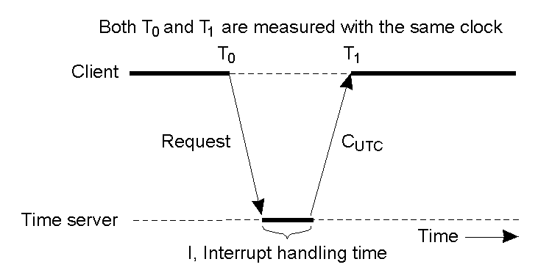
Cristian's Method
V1-4
Time in Distributed Sytems

Slide 19
Cristian's Method
Based on a central server (S)containing an accurate time source.
Client process P sends a message Mr to S requesting the time.
S sends back the current time Ttrans in a message Mt.
The round trip time as measured by P is Tround.
V1-4
Time in Distributed Sytems

Slide 20
Cristian's Method
Cristian assumes the network and os delays are equal for both Mr and Mt.
Hence the new time on P, Pnew will be:
Pnew = Ttrans + (Tround/2)
If the characteristics of the network are know e.g. jitter then the accuracy of the clock can be characterized.
V1-4
Time in Distributed Sytems

Slide 21
Cristian's Method
The algorithm has described has a single point of failure.
This can be overcome by having multiple time servers, broadcasting Mr from P and accepting the first reply.
V1-4
Time in Distributed Sytems

Slide 22
Berkeley Algorithm
Developed by Gusella and Zatti.
Synchronizes computers running Berkley UNIX (BSD).
A cordinator is choosen.
The cordinator polls the slave systems for their local time.
Collected times are adjusted for round trip transmission times.
V1-4
Time in Distributed Sytems

Slide 23
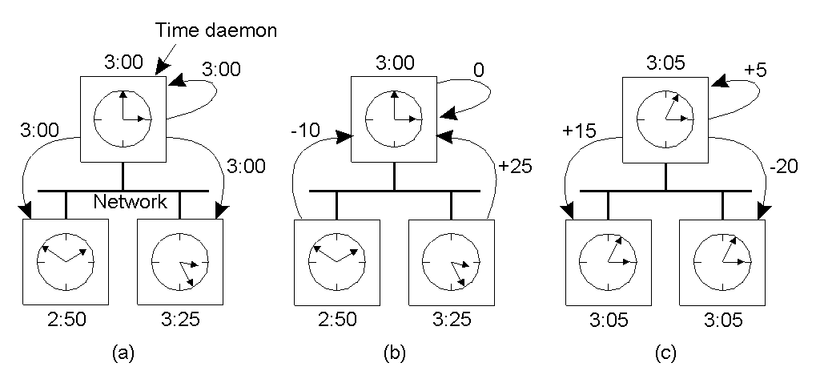
Berkeley Algorithm
V1-4
Time in Distributed Sytems

Slide 24
Berkley Algorithm
The times are averaged, ignoring extreme times.
The average time is used to calculate an offset for each system.
Adjustment is sent to each system
V1-4
Time in Distributed Sytems

Slide 25
Berkley Algorithm
Relies on some clocks being fast and some slow.
The whole system can drift from Universal Time if the clocks do not average out.
Any system become coordinator if the existing coordinator fails.
V1-4
Time in Distributed Sytems

Slide 26
Network Time Protocol (NTP)
Developed by David Mills
http://www.eecis.udel.edu/~ntp
Synchronises time across the Internet
V1-4
Time in Distributed Sytems

Slide 27
Network Time Protocol (NTP)
NTP needs some reference clock that defines the true time to operate. All clocks are set towards that true time. NTP uses UTC as reference time.
NTP is a fault-tolerant protocol that will automatically select the best of several available time sources to synchronize to.
NTP is highly scalable.
V1-4
Time in Distributed Sytems

Slide 28
Network Time Protocol (NTP)
A synchronization network may consist of several reference clocks. Each node in a synchronization network can exchange time information either bidirectional or unidirectional.
Propagating time from one node to another forms a hierarchical graph with reference clocks at the top.
V1-4
Time in Distributed Sytems

Slide 29
Network Time Protocol (NTP)
NTP can select the best time sources to build its estimate of the current time. The protocol is highly accurate, using a resolution of less than a nanosecond (about 2^-32 seconds). (
The popular protocol used by rdate and defined in [RFC 868] only uses a resolution of one second.
Even when a network connection is temporarily unavailable, NTP can use measurements from the past to estimate current time and error.
V1-4
Time in Distributed Sytems

Slide 30
Network Time Protocol (NTP)
Design goals
  Synchronize Internet clients to UTC
  Survive lengthy losses of connectivity
  Enable clients to frequently re-synchronize
  Provide protection against an errant time service
V1-4
Time in Distributed Sytems

Slide 31
Network Time Protocol (NTP)
Organized as a logical tree.
Primary servers occupy Stratum 1 and are directly connected to a time source.
Secondary servers Stratum 2 and higher.
Synchronise with lower stratum.
The lower the stratum the more accurate the clock.
V1-4
Time in Distributed Sytems

Slide 32
Network Time Protocol (NTP)
Synchronization modes
  Multi-cast
  Procedure call mode
  Symmetric mode
V1-4
Time in Distributed Sytems

Slide 33
NTP – Multicast mode
Generally used on higher stratum e.g. LANs
Servers periodically broadcast the time.
Receivers update their clocks allowing for transmission delays.
Least accurate mode
Generally services end user systems
V1-4
Time in Distributed Sytems

Slide 34
NTP – Procedure Call Mode
Similar to Cristian’s algorithm.
One server acts as a time source for others.
Request are made and time is served up
Adjustments made for network delays
More accurate than Multi-cast mode
V1-4
Time in Distributed Sytems

Slide 35
NTP - Symmetric mode
Used at the lower strata.
Provides accurate synchronisation.
Pairs or servers continually exchange time information.
May be piggy backed onto existing messages.
V1-4
Time in Distributed Sytems

Slide 36
NTP - Symmetric mode
t₂
t₃
t
m₁(t₁)
Θ
m₂(t₁, t₂, t₃)
t₁
t₄
t
V1-4
Time in Distributed Sytems

Slide 37
NTP - Symmetric mode
t₂
t₃
t
Let: a = t₂ – t₁ and b = t₃ – t₄
Round trip delay = δ = a - b
Offset = Θ = (a + b)/2
m₁(t₁)
Θ
m₂(t₁, t₂, t₃)
t₁
t₄
t
V1-4
Time in Distributed Sytems

Slide 38
NTP - Symmetric mode
t₂= 10
t₃ = 12
t
m₁(t₁)
Θ
m₂(t₁, t₂, t₃)
t₁ = 15
t₄ = 18
t
a = t₂ – t₁ = -5 b = t₃ – t₄ = -6
δ = a – b = 1
Θ = (a + b)/2 = -11/2 = 5.5
V1-4
Time in Distributed Sytems

Slide 39
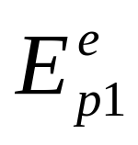
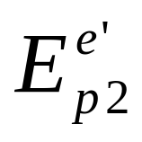
Logical Time
Synchronisation with UT is useful but often unnecessary
If is frequently only necessary to know that:
happened before
where e and e’ are events
and p₁ and p₂ are processes.
V1-4
Time in Distributed Sytems

Slide 40
Logical Time
Lamport (Time, Clocks and the Ordering of Events in a Distributed System, Lamport, CACA V21 N7, 1978) first pointed out that clock synchronization need not be absolute.
If two processes do not interact their clocks do not need to be sychronised because the lack of synchronisation is not observable.
V1-4
Time in Distributed Sytems

Slide 41
Logical Time
If systems do interact they do not have to use real time to synchronise events:
  they could operate at UT – n seconds
  they could use a monotonically incrementing number.
Such systems use Logical Clocks
V1-4
Time in Distributed Sytems

Slide 42
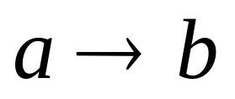
Logical Clocks
Lamport defined the happens before relationship:
  a happens before b
This relationship is observable when:
  a and b are events in the same process
  a is the event of sending a message and b is the event of receiving it.
V1-4
Time in Distributed Sytems

Slide 43
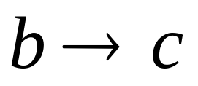

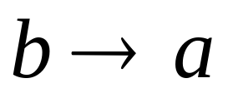
Logical Clocks
The happens before relationship is transitive if :
if neither
  are true then such events are said to be concurrent.
  Read Lamport paper in \\ecenotes\ce4208
and
then
or
V1-4
Time in Distributed Sytems

